Slide 1
Tax Aspects of Further Devolution Proposals
Professor David Bell
University of Stirling

Slide 2
What is a “vertical fiscal imbalance”
“Funding by block grant alone means that while the Scottish Parliament is completely accountable for the spending of its budget, it is not accountable for the total of that budget or how it is raised; it has no fiscal powers that can be used as policy instruments and it does not have a direct financial stake in the performance of the Scottish economy” (Commission on Scottish Devolution, 2009, para 3.87)

Slide 3
Building the Tax Base
1998 Scotland Act
Income Tax - 3p on Basic Rate
2012 Scotland Act
Income Tax - 10p Rate
Stamp Duty Land Tax
Landfill Tax
Smith Proposals
Income Tax – all except Personal Allowance, Savings and Investment
VAT – half of all duty raised in Scotland
Air Passenger Duty
Aggregates Levy

Slide 4
Who is the “Scottish Taxpayer”?
A Scottish taxpayer is defined as someone who is UK resident for tax purposes and who has their only or main place of residence in Scotland for all or the majority of the tax year.
Any UK employer who employs Scottish taxpayers will be affected. HMRC anticipates that in the months leading up to April 2016, they will identify those who are Scottish taxpayers based on addresses held on their systems and write to individuals with Scottish addresses and give them the opportunity to say whether they agree.
HMRC will be issuing notices of coding containing an ‘S’ suffix to employers to identify employees who hold Scottish taxpayer status. Employers will then be required to deduct and account to HMRC for Scottish taxes at the appropriate rates through the PAYE system, as they do currently.

Slide 5
The Smith Commission proposals: tax
Tax | Extent of devolution | Equivalent receipts, 2012/13
Income tax | Rates and thresholds fully devolved; Personal allowance and reliefs reserved; Tax on savings and dividend income reserved | £10.8bn
VAT | Half of revenues in Scotland assigned to Scottish Parliament | £4.7bn
Air Passenger Duty | Fully devolved | £0.23bn
Aggregates Levy | Design and collection fully devolved | £0.04bn

Slide 6
Scotland Act 2012: tax powers
Landfill tax: £0.1bn
Land and buildings transaction tax: £0.4bn
Scottish Rate of Income Tax (SRIT): £4.7bn
Plus already devolved council tax (£2bn) and NDR (£2.8bn)
HM Government
45p
40p
Income Tax
Rate
20p
10p
Scottish Government
£10k
£42k
£150k
£200k?

Slide 7
Comparing SRIT and Smith Proposals
45p
40p
20p
10p
£10k
£42k
£150k
£200k?

Slide 8
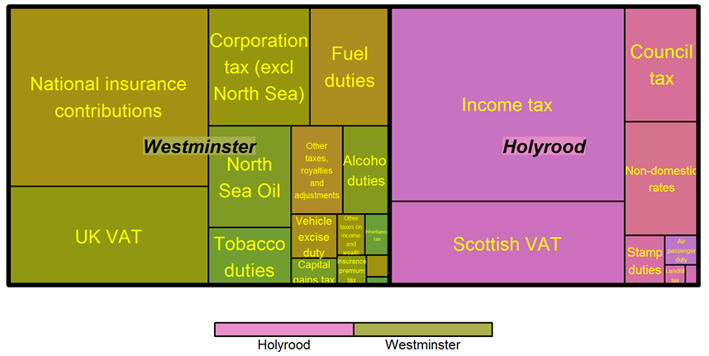
Division of taxes between Holyrood and Westminster
Notes:
Scottish revenue share will be 37%, compared to 6% currently

Slide 9
The Smith Commission proposals: welfare
Welfare benefits to be devolved to the Scottish Parliament:
Benefits for carers, disabled people and those who are ill: Attendance Allowance, Carer’s Allowance, Disability Living Allowance (DLA), Personal Independence Payment (PIP), Industrial Injuries Disablement Allowance and Severe Disablement Allowance.
Benefits which currently comprise the Regulated Social Fund: Cold Weather Payment, Funeral Payment, Sure Start Maternity Grant and Winter Fuel Payment.
Discretionary Housing Payments

Slide 10
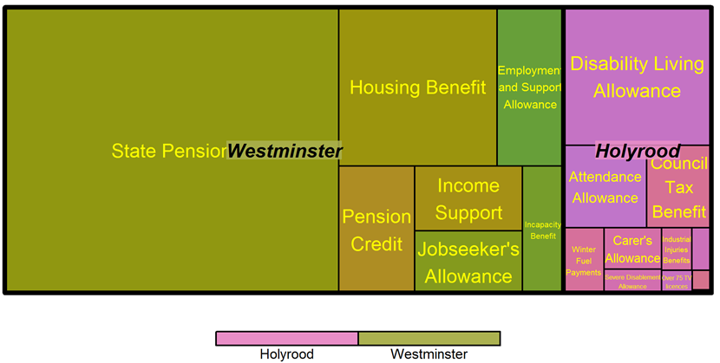
Division of welfare spending, Holyrood and Westminster
Notes:
Newly devolved stuff is £2.6b plus already devolved CTB is £0.4bn. Total DWP spend in Scotland is £14.8b (inc CTB) plus tax credits (not shown in graph) are £2.3bn. So SG will control £3bn welfare budget out of £17bn, i.e. 18%.

Slide 11
Summary of new tax and spend powers
Additional revenue powers | £m
Income tax | £10,865
VAT | £4,674
Land and Buildings Transactions Tax | £283
APD | £234
Landfill Tax | £100
Aggregates levy | £45
Total | £16,201
Additional spending powers | £m
Attendance Allowance | £489
DLA/Personal Independence Payment (PIP) | £1450
Carer’s Allowance | £169
Industrial Injuries Disablement Allowance | £92
Severe Disablement Allowance | £97
Winter Fuel Payment | £187
Others (cold weather payment, funeral payment, sure start maternity grant, work programme) | ≈£100
Total | £2,550

Slide 12
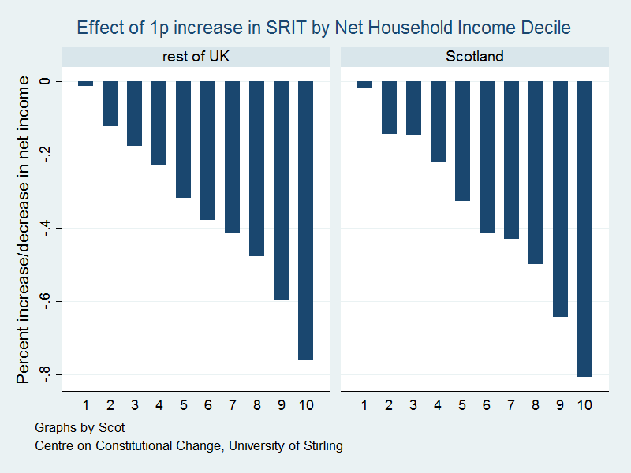
1p increase in SRIT: Effects by Net Income Decile

Slide 13
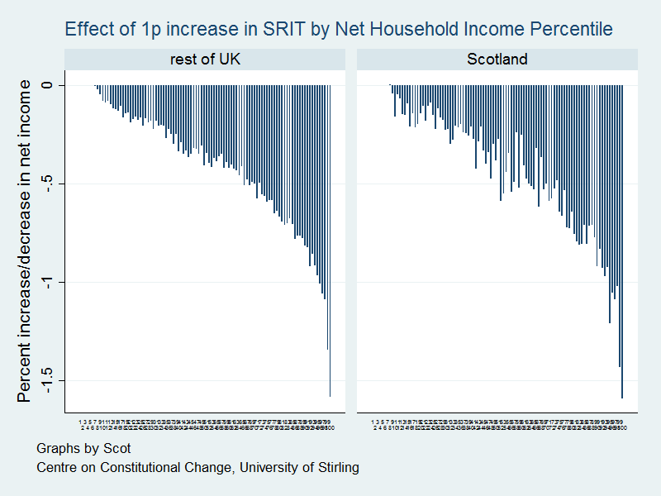
1p Increase in SRIT: Effects by Net Income Percentile

Slide 14
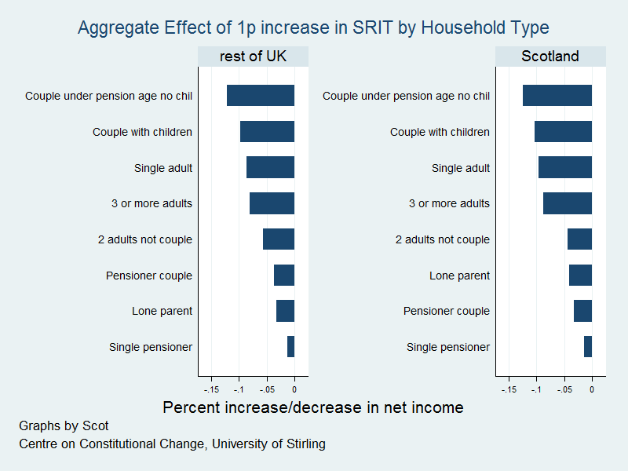
Effects of SRIT increase by Household Type

Slide 15
Scotland’s block grant: mechanics
Year 0
Block grant
In year 1, value of block grant is reduced by BGA:
Year 1
BGA determined by value of devolved taxes in year 1
Block grant
Block grant adjustment (BGA)
Year 2
Change in block grant determined by change in comparable spend in England
Change in BGA determined by % change in comparable UK tax
Block grant
Block grant adjustment

Slide 16
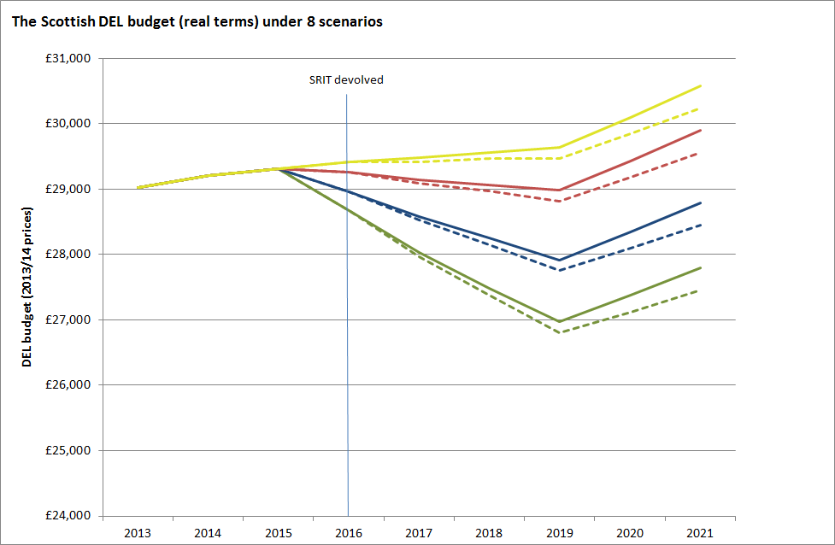
Scottish budget evolution under 8 scenarios

Slide 17
Other issues/ principles from Smith
Borrowing Powers to both ensure budgetary responsibility and support capital investment… but not yet clear on limits/ rules
Requirement to strengthen independent fiscal scrutiny
Economic responsibility: Scottish budget bears costs and benefits of fiscal policy decisions
Principle of “no detriment”: reimbursement of UK govt. for costs of Scottish fiscal decisions (and vice versa)… but how to implement in practice?

Slide 18
Tax powers in other nations?
Wales
Power over landfill taxes, stamp duty and the aggregates levy will pass to Cardiff Bay in 2018.
Devolution of income tax powers will be subject to a referendum.
Northern Ireland
Devolution of the rate-setting power for corporation tax (CT) in NI to the Northern Ireland Assembly (NIA) for trading profits only, subject to a commencement order.

